Slide 1

Agrolife:ML enabled Plant Disease Classification System
Group No. 19
Ruta Mhaskar 19104013
Anagha Rai 19104030
Ishika Sharma 19104061
Project Guide and Co-Guide
Prof. Sonal Jain
Prof. Charul Singh
Notes:
‹#›

Slide 2
Contents
Abstract
Introduction
Objectives
Literature Survey
Problem Definition
Technological Stack
Proposed System Architecture/Prototype
Suggestions given during Review 1
Notes:
‹#›

Slide 3
1. Abstract
Agrolife aims at detecting whether the plant is diseased or not and if yes, classify the disease caused. Along with this, the system will provide a gist about the disease with few easy home remedies(if applicable) and guide the user to take proper consultation.
Convolutional Neural Network (CNN), a Deep Learning technique, is used which takes input from the user in the form of image data and displays the type of disease along with some remedies. Also, some other softwares used are Tensorflow(for preprocessing of data), Google cloud server(for deployment) and React Native(for mobile app). This, thus, would help in preventing the loss of crops resulting in an increase in production.
Notes:
‹#›

Slide 4
2. Introduction
Agriculture is extremely important in developing countries like India, however food security still remains the vital issue.
Problem Identified :
Due to various factors such as temperature, pollution, pests and many more, the plants get diseased.
These diseased plants are sometimes not evident enough to identify what kind of disease it has.
This results in mass deduction of food production.
Notes:
‹#›

Slide 5
Solution Proposed :
This project focuses on studying and identifying whether the plant is diseased.
If so, we provide a gist about the disease with some home remedies and guide the user to take proper consultation.
Deep learning technique-CNN used here takes input from the user and displays the type of disease with its description and some remedies.
This thus, will help in preventing the loss of crops and also elevate growth in production.

Slide 6
3. Objectives
To detect the crop disease using Convolutional Neural Network algorithm.
To give right knowledge to the users about which disease the crop has based on the image classification.
To help predict disease and display the actions to be taken at the right time.
To provide information about the disease predicted to the user and help them make an informed decision before taking appropriate measures.
Notes:
‹#›

Slide 7
4. Literature Survey
SR. NO. | PAPER NAME | FINDINGS
1. | Marzougui, F., Elleuch, M., & Kherallah, M. (2020). A Deep CNN Approach for Plant Disease Detection. 2020 21st International Arab Conference on Information Technology (ACIT). doi:10.1109/acit50332.2020.9300072 | Applies Deep Learning method- CNN which classifies the input leaf images as diseased or disease-free. Anaconda is used to compare their performances.
2. | Liu, J., Wang, X. Plant diseases and pests detection based on deep learning: a review. Plant Methods 17, 22 (2021). https://doi.org/10.1186/s13007-021-00722-9 | The review provides a definition of plant diseases and pests detection problems, and puts forward a comparison with traditional plant diseases and pests detection methods.
Notes:
‹#›

Slide 8
4. Literature Survey
SR. NO. | PAPER NAME | FINDINGS
3. | Saleem, M.H.; Potgieter, J.; Arif, K.M. Plant Disease Detection and Classification by Deep Learning. Plants 2019, 8, 468. https://doi.org/10.3390/plants8110468 | Provides a comprehensive explanation of Deep Learning models used to visualize various plant diseases. Additionally, some research gaps are identified from which to obtain greater transparency for detecting diseases in plants, even before their symptoms appear clearly.
4. | L. Li, S. Zhang and B. Wang, "Plant Disease Detection and Classification by Deep Learning—A Review," in IEEE Access, vol. 9, pp. 56683-56698, 2021, doi: 10.1109/ACCESS.2021.3069646. | Provides the research progress of deep learning technology in the field of crop leaf disease identification in recent years and discusses some of the current problems that need to be resolved.
Notes:
‹#›

Slide 9
5. Problem Definition
Farmers' economic growth is determined by the quality of the goods they produce, which is dependent on plant growth and yield.
As a result, in the field of agriculture, disease identification in plant leaves is important.
It takes a long time to manually diagnose plant leaves’ disease through naked eye.
Thus, computational methods need to be developed to automate the process of disease detection and classification using leaf image classification.
Notes:
‹#›

Slide 10
6. Technology Stack
HTML, CSS, Bootstrap for interface
Python (version 3.9.2)
Tensorflow for preprocessing the data
Deep Learning using CNN model
Google Cloud/ AWS Cloud Server for deployment
React Native for Mobile App
Notes:
‹#›

Slide 11
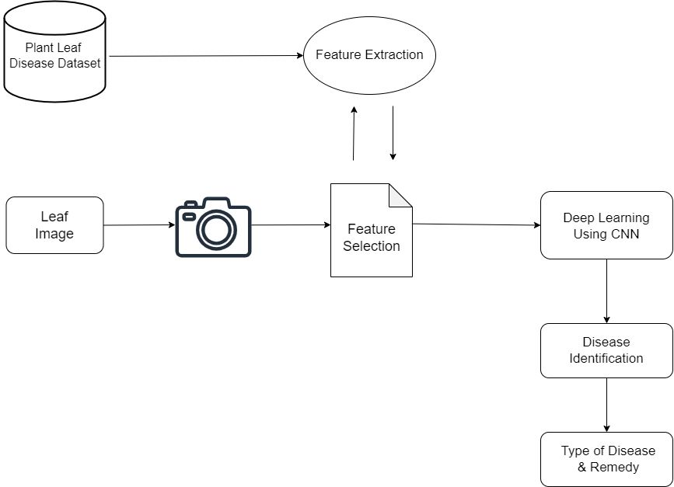
7. Proposed System Architecture/Prototype
Notes:
‹#›

Slide 12
7. Proposed System Architecture/Prototype
Feature 1: There is a database which consists of all the different plant leaf diseases which we have taken into account as shown in the figure
Feature 2: The module is trained repetitively to attain the maximum accuracy. If a new image is given to the module its features get compared with the features that are already trained in the database. It then provides the appropriate result.
Feature 3: The proposed system gives a gist of the disease detected along with some simple remedies (if applicable) to consider before consulting an expert.
Notes:
‹#›

Slide 13
8. Suggestions given during Review 1
Changes in objective We elaborated the objectives by specifying the technology that we will be using.
Literature Survey
We add our base paper as the first in the list of literature survey
Notes:
‹#›

Slide 14
Thank You...!!
Notes:
‹#›

